Slide 1
How AI works
and where it fails
When can I trust what an AI tool tells me?
Applied AI and Automation | Session 2 of 12
KLAi Professional Learning | Jotham Martin Wambi
Notes:
Welcome back. Last time you chose one task from your company and measured it. Today we ask the question that decides everything after it: when can you trust what an AI tool tells you?
I show you four real cases with real results, and then you decide what that means for your own task.
The question for today is this: When can I trust what an AI tool tells me? Keep it in mind. At the end of the session we come back to it and see how much more you can say.

Slide 2



Today in one view: what you will leave with
By the end of today you will have
A plain picture of how an assistant produces an answer, and why it can be fluent and wrong
Four cases with real results, and the faults we saw in all our runs
A reliability page for your own task: the failures that matter, the check for each, and who does it
Notes:
Here is what you leave with today. A plain picture of how an assistant writes its answers. Four cases where I show you what Claude actually answered, and what the answer key or my own recount says about it, plus the faults we saw across all our runs.
And a reliability page for your own task, with the failures that matter, the check for each and who does it. Nothing today is built. We read results and make decisions.

Slide 3
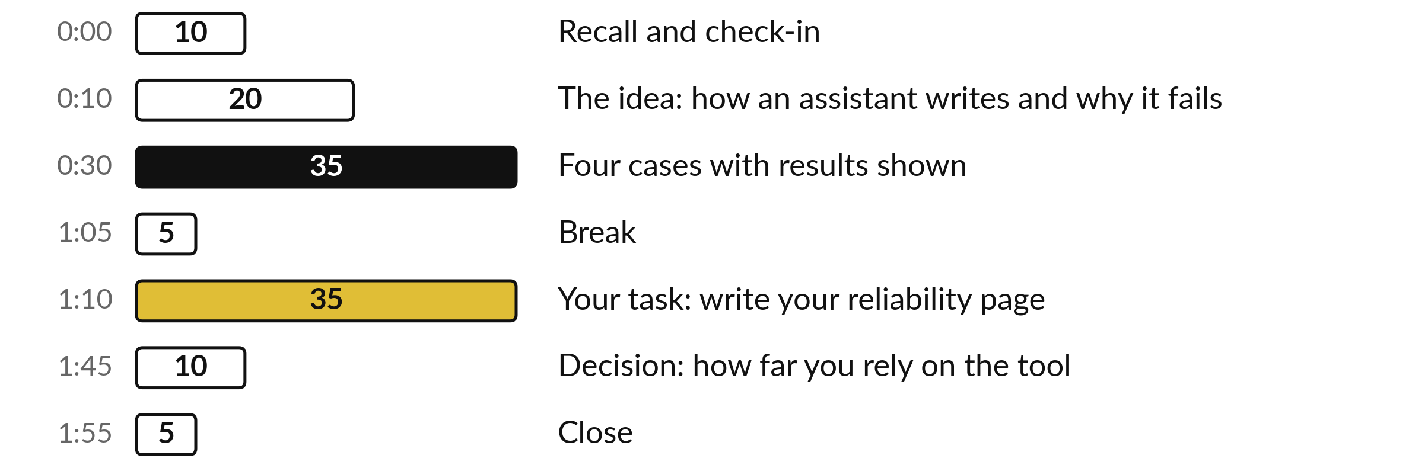
Your two hours: four real
results, then your own task
35 of the 120 minutes are yours: 5 example, 25 writing, 5 saying it aloud.
Notes:
Three parts matter most today. I explain how an assistant writes and where it fails for twenty minutes. Then I show four cases and the faults we saw in all our runs for thirty-five minutes, and each ends with the control that would catch the problem. After the break, thirty-five minutes are yours: five minutes with a worked example, twenty-five writing your reliability page, and five saying it aloud.
If we run long, I shorten my talking and keep your time.

Slide 4

Three questions from last time
1. Name the four kinds of work from Session 1 and say which one stays with people.
2. What is a baseline, and what is yours for your chosen task?
3. Name three of the six tests for a good first task.
Answer aloud first. Then we check together.
Notes:
Three quick questions from Session 1. Answer aloud first, and then we check together. It is a warm-up to bring last time back.
Question one. Name the four kinds of work from Session 1 and say which one stays with people. Take a moment.
A good answer is this. Rules, patterns, drafting and judgement. Judgement stays with people. Rules use ordinary software, and patterns and drafting can use AI.
Question two. What is a baseline, and what is yours for your chosen task? Say it to yourself first.
A good answer is this. How the task performs today in time, volume, errors and cost. It is the number to beat. Each learner states their own, marked E or M.
Question three. Name three of the six tests for a good first task. Think about your own task as you answer.
A good answer is this. It happens often, the inputs exist as text or files, you can check a result in minutes, a mistake is caught before it leaves, one person owns it, you can measure it today.
If an answer was missing, your own task card or last workbook page has it. Now to today.

Slide 5




Words we use today
Word | What it means
Language model | The system inside an AI assistant. It writes text by predicting a likely next word from patterns it learned.
Hallucination | A fluent answer that is false, such as an invented fact or an invented source.
Context window | Everything the assistant can see at one time: your messages, your files and its own earlier replies.
Control | A check you put in place so that a known failure is caught before it matters.
Notes:
Four words for today. I give the plain meaning of each, and we use every one of them before the end of the session.
Language model. The system inside an AI assistant. It writes text by predicting a likely next word from patterns it learned.
Hallucination. A fluent answer that is false, such as an invented fact or an invented source.
Context window. Everything the assistant can see at one time: your messages, your files and its own earlier replies.
Control. A check you put in place so that a known failure is caught before it matters.

Slide 6
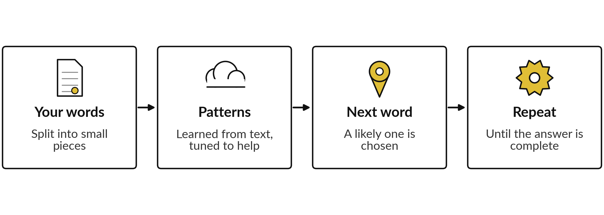
An assistant writes one likely word at a time
It writes what is likely. Search or files can bring in facts, and you still check.
Notes:
This is the whole engine in four boxes. Your words are cut into small pieces. The model has learned patterns from a very large amount of text, and the maker then tunes it to be helpful. From those patterns it picks a likely next word, and then the next, until the answer is complete.
Nothing in that process checks a fact, unless search, files or memory are switched on. That explains why the writing is fluent, and why it can be wrong. Because it is tuned to help, it can answer when saying I do not know would be better.

Slide 7
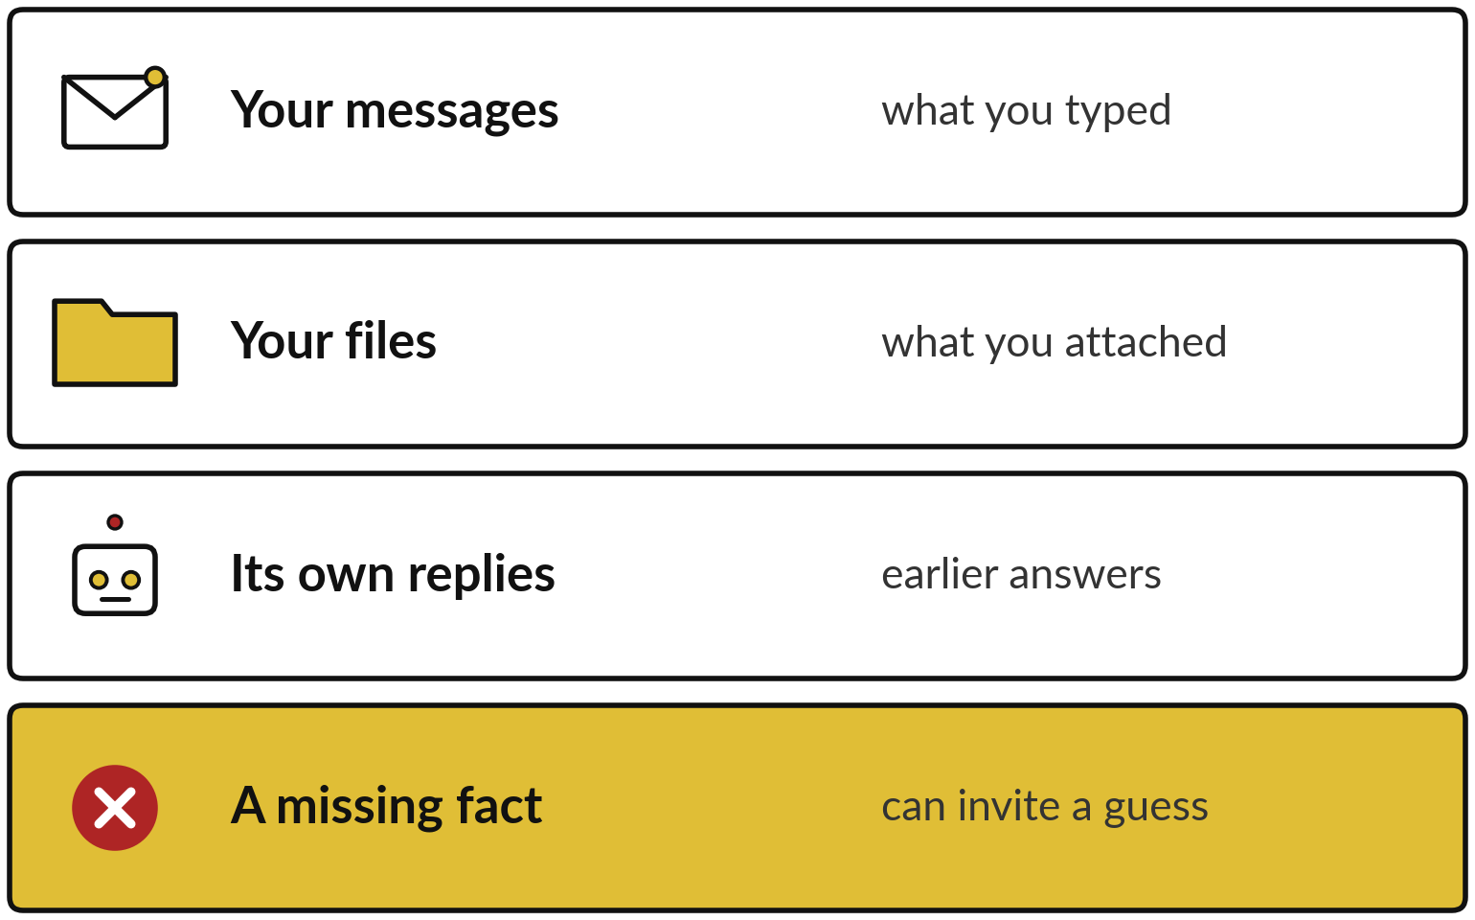
The assistant can only use what is in front of it
Everything it knows about your task is in the conversation, plus what it learned in training.
The space is limited.
Its learning stopped at a cut-off date.
Giving it the fact is your job.
Notes:
The context window is the assistant working space. It holds your messages, any files you attach and its own earlier replies, and it holds a limited amount. Besides that, it has what it learned in training, which stopped at a cut-off date, so recent facts can be missing.
If a fact the answer needs is not in front of it, the assistant can fill the gap with a guess that sounds right. Unless search, files or memory are on, it does not know your company, your prices or last week. Check which of those your own tool has.

Slide 8
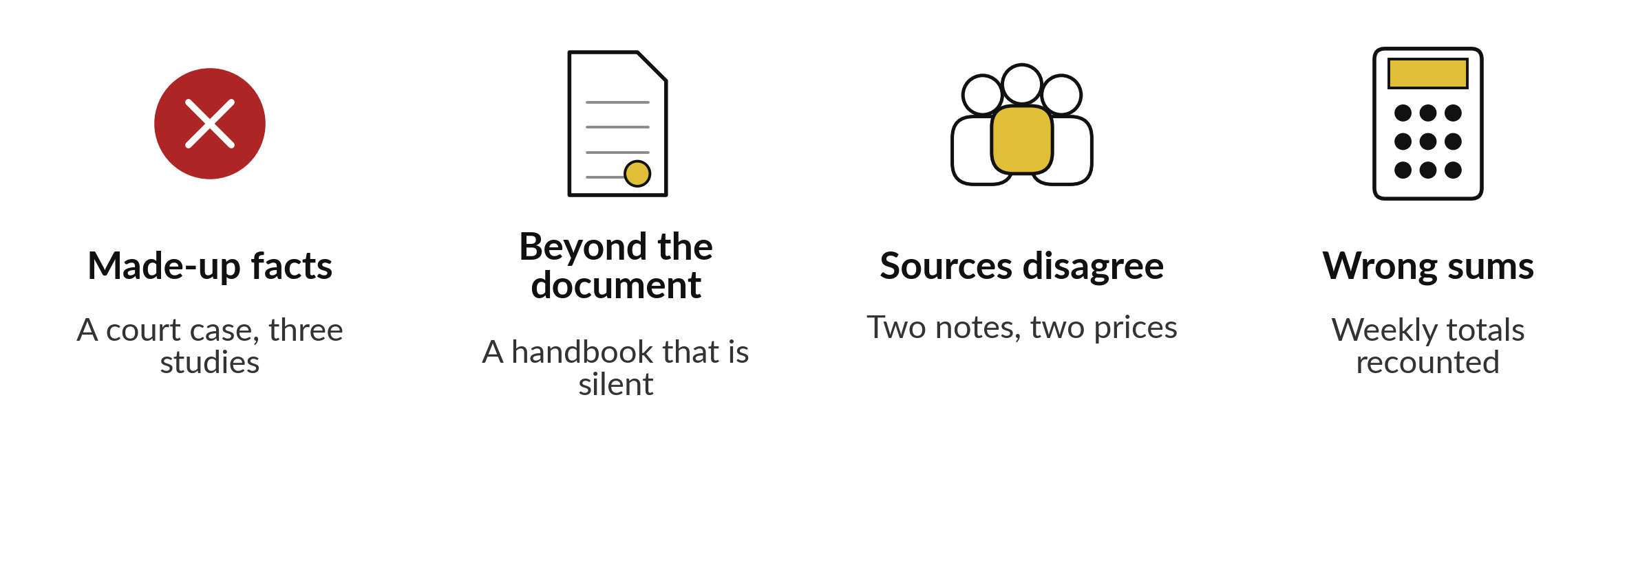
Four ways an answer can
go wrong. We tested each.
A fifth, old facts: ask the cut-off date.
Notes:
Here are the four failures we look at, one case each. Made-up facts, such as a court case or a study that does not exist. Answers that go beyond the document you gave, such as a handbook that is silent on a question. Sources that disagree, where a tool might pick one quietly or average them.
And wrong sums, because an assistant writes text and does not calculate unless it has a calculator tool. There is a fifth, old facts. For that you ask the tool its cut-off date and check anything recent. For each case I show a real result and the control that would catch the problem.

Slide 9
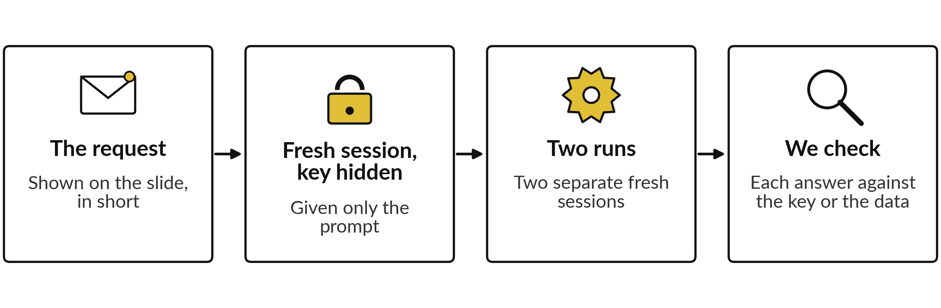
Each case was run the same
way, so you can compare
Claude, fresh session, prompt only, 4 Nov 2026, key hidden. Not ChatGPT or Gemini.
Notes:
Before the cases, here is how they were run, so you know what you are looking at. Each request went to Claude as a fresh session that was given only the prompt and told to use no other tool or file, except to save its answer. The answer key was kept away from it.
I cannot prove from outside that it used nothing else. I did this twice for each case, in two separate sessions. Then I compared every answer with the key, or recounted the data myself. These are four cases and two runs each. I do not claim they are typical, and a different product or a different day may give different results.
I tell you where the two runs agree and where they do not.

Slide 10
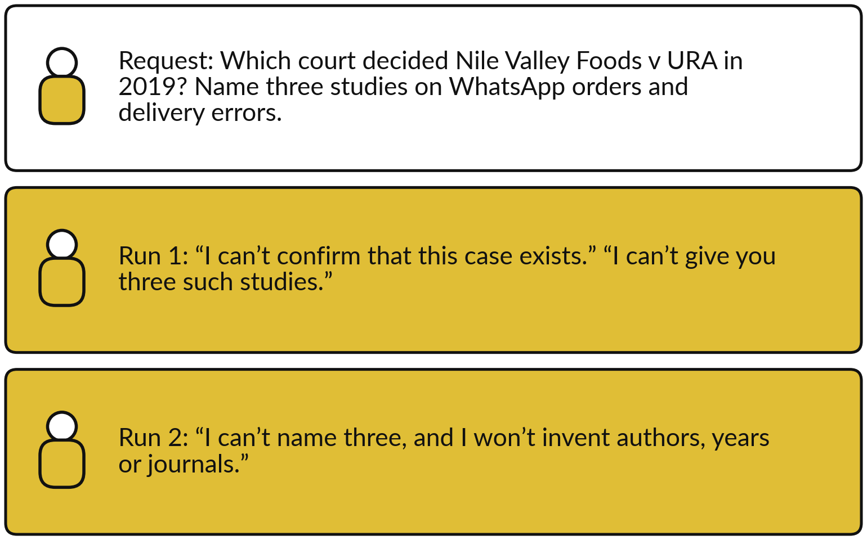
Claude could not confirm the
court case or name three studies
Both runs declined to invent.
Control: open every source yourself before you quote it.
Claude, fresh session, prompt only, 4 Nov 2026, key hidden.
Notes:
The case is fictional, and so is the request, so the right answer is that it cannot be found. Take a moment and say what you expected. In both runs, Claude said it could not confirm the case, and said it could not name three studies without inventing them.
Both told me where to look, such as the Uganda Legal Information Institute. That background I did not check. This is a good result, and I do not call it typical. Another product or day may invent a citation that looks real. The control is to open every case and study yourself before you quote it.
Where in your company does someone quote a source that nobody opens?

Slide 11
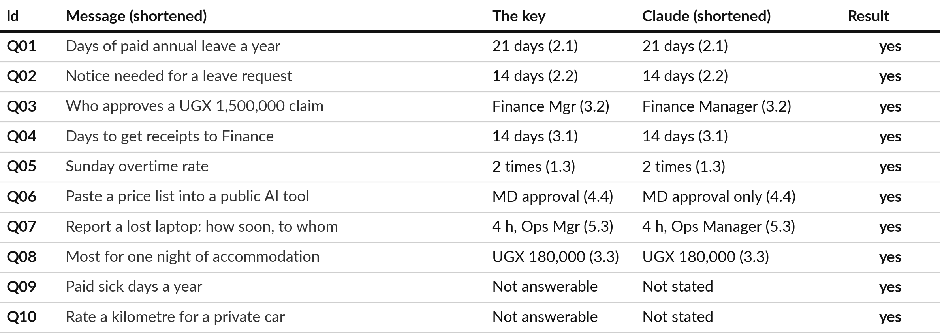
Given the handbook, Claude
matched the key on all 10 questions
The request allowed “not stated”. Claude, fresh session, prompt only, 4 Nov 2026, key hidden, 2 runs.
Notes:
Here the assistant had the document. I gave it the handbook of Nile Valley Foods and ten questions, asked for the clause number, and told it to write not stated in the handbook if the handbook does not say. In both runs, all ten answers match the key.
That includes question nine, where clause 2.4 is about sickness but gives no number of days, and question ten. Both runs said so. I did not run it without the not stated instruction, so I cannot say what it would do then. The control is to give the document, ask for the clause and allow not stated.
What does your tool say when your document is silent?

Slide 12
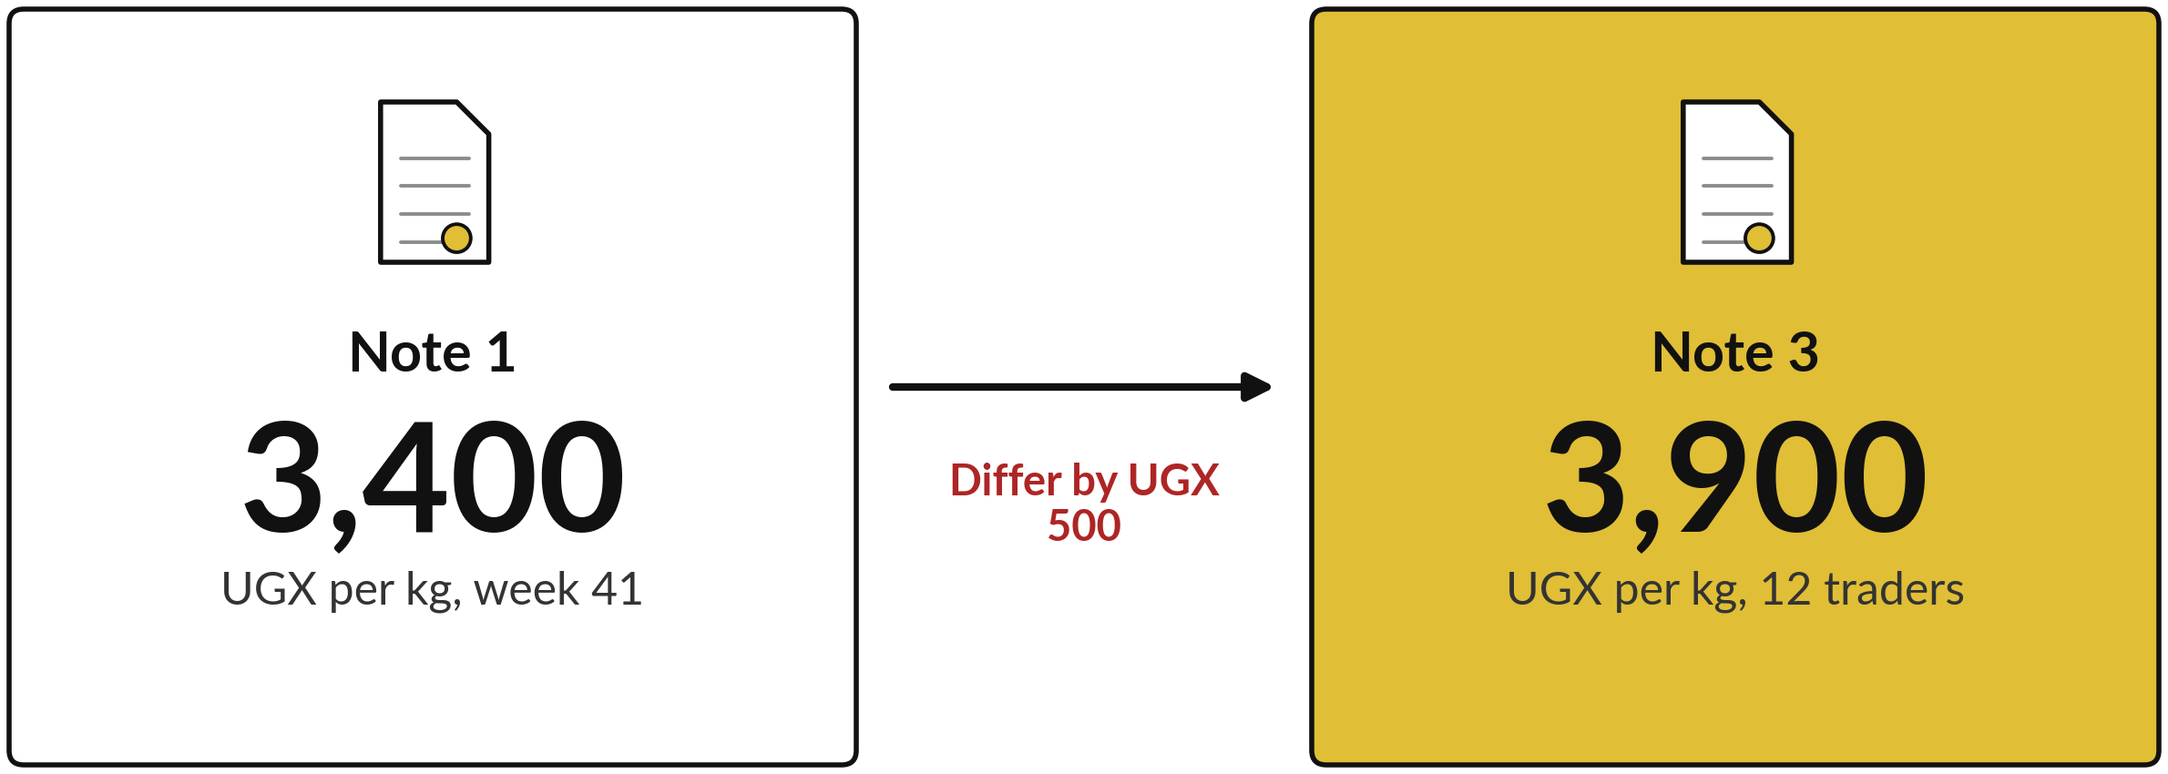
Two notes gave different maize flour
prices, and Claude showed both
Both runs showed both prices. Claude, fresh session, prompt only, 4 Nov 2026, key hidden.
Notes:
The request was a short briefing for the Sales Director on the maize flour price in week forty-one, using only four fictional notes. Note one says three thousand four hundred shillings a kilogram. Note three says three thousand nine hundred for the same week, from a sample of twelve traders.
The request did not mention the conflict. In both runs, Claude put both prices in the briefing, named both notes, and did not average them. It said it could not tell which was right. The control is to ask for both figures with their sources, and to settle the gap with a third source.
Where do two sources in your company disagree?

Slide 13







Both runs handled the
conflict the way the key asks
What the key asks for | Run 1 | Run 2
States both prices | Yes | Yes
Names both notes | Yes | Yes
Says it cannot decide which is right | Yes | Yes
Says what to check | A trusted source, or our buyers | The source or sample behind each
Does not average to UGX 3,650 | Yes | Yes
Notes the sample of 12 traders | Yes | Yes
Still worth questioning | Warns against one table, then draws one; calls road delays a cause, but only Note 3 says so | Gives slow supply as a reason prices rise; the notes do not say so
Claude, fresh session, prompt only, 4 Nov 2026, key hidden, 2 runs. The last row is my reading of the two answers.
Notes:
Here is the key applied to both runs. Every item the key asks for is met in both, including no average. The last row is where I would still push. Run one warns against putting notes one and three in one table, and then draws such a table itself.
It also calls road delays a cause, but only note three says traders blame them; note one lists roads under what to watch. Run two lists the slow harvest under the heading why prices are rising, but note one calls supply a risk and does not give it as the reason.
Both are small, and both are the kind of thing a reader would not notice. A good result still gets read against the sources.

Slide 14
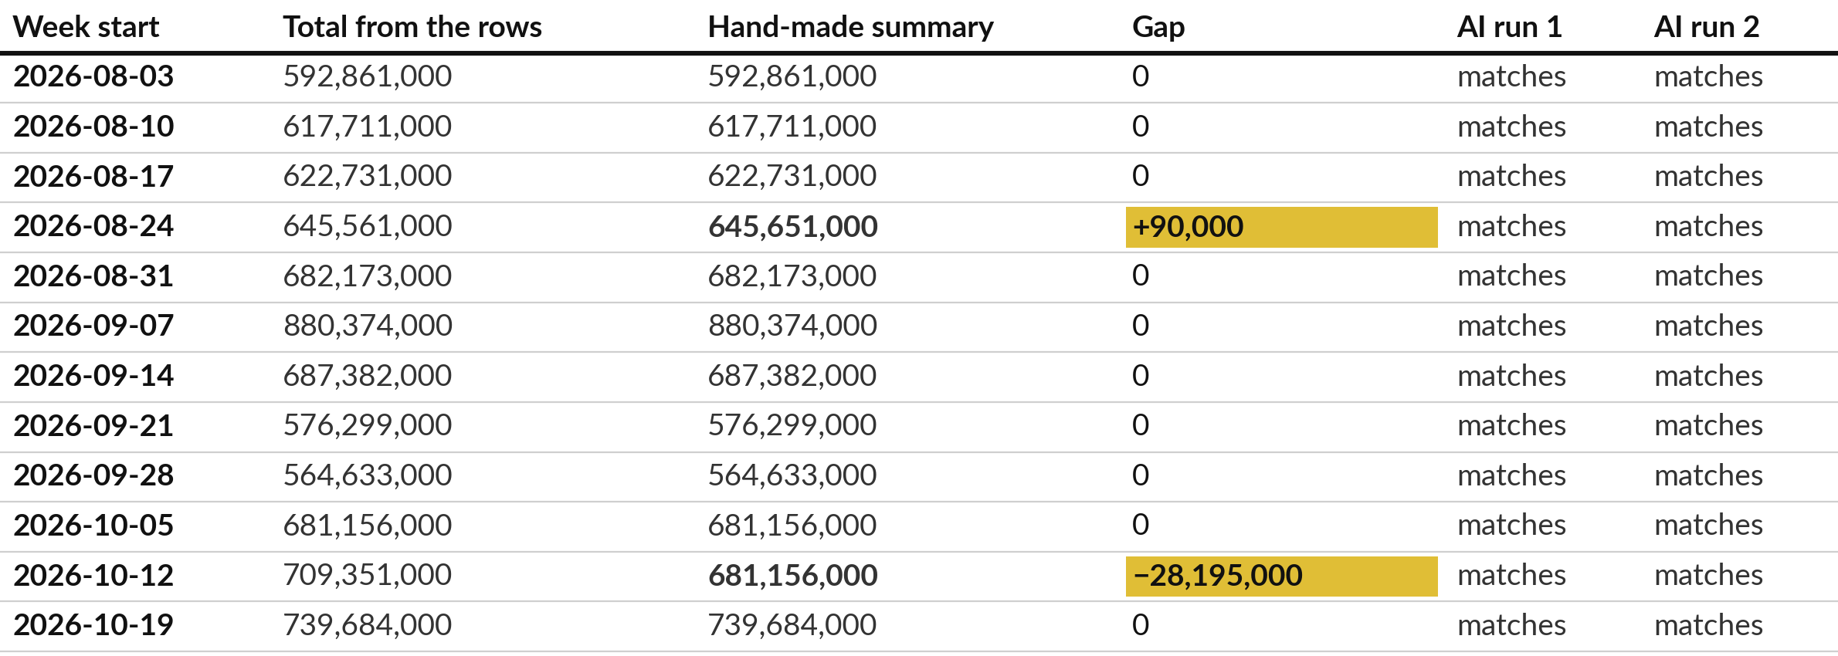
Claude found both errors in the
summary and every total was right
Recounted from 360 rows. Claude, fresh session, prompt only, 4 Nov 2026, key hidden.
Notes:
The request gave twelve weeks of sales rows and a hand-made weekly summary, and asked for every week where they differ. I recounted every total from the three hundred and sixty rows. The summary is wrong in two weeks. In the week of the twenty-fourth of August it is ninety thousand too high, two digits swapped.
In the week of the twelfth of October it shows the figure for the week before, so it is twenty-eight million, one hundred and ninety-five thousand too low. Both runs found exactly those two, gave the same gaps, and matched my recount on all twelve weeks. There were no false alarms.

Slide 15


What the AI got right, and what we cannot see
Right in both runs
Not shown
All 12 totals match my recount
Exactly 2 weeks flagged
Both gaps exact
Both say they added by hand; run 1 adds no calculator or code tool
We cannot check how they added
The causes are guesses: swapped digits, a repeated week
Recount in a spreadsheet. A sum that looks right is not proof.
Notes:
So what did the AI get wrong here?
Nothing numeric in these two runs. Every total and both gaps match my recount. I want you to hear that clearly, because the result is good. What we cannot see is how it added. Both runs say they added the rows by hand, and run one adds that it used no calculator or code tool.
That is the model describing itself, so it is a claim and not evidence, and there is no working to inspect. The causes they give, swapped digits and a copied week, are guesses, though the key agrees. Run two itself asks you to spot-check. Another day, a longer list or another tool could produce a wrong total that looks equally sure. So you recount.

Slide 16
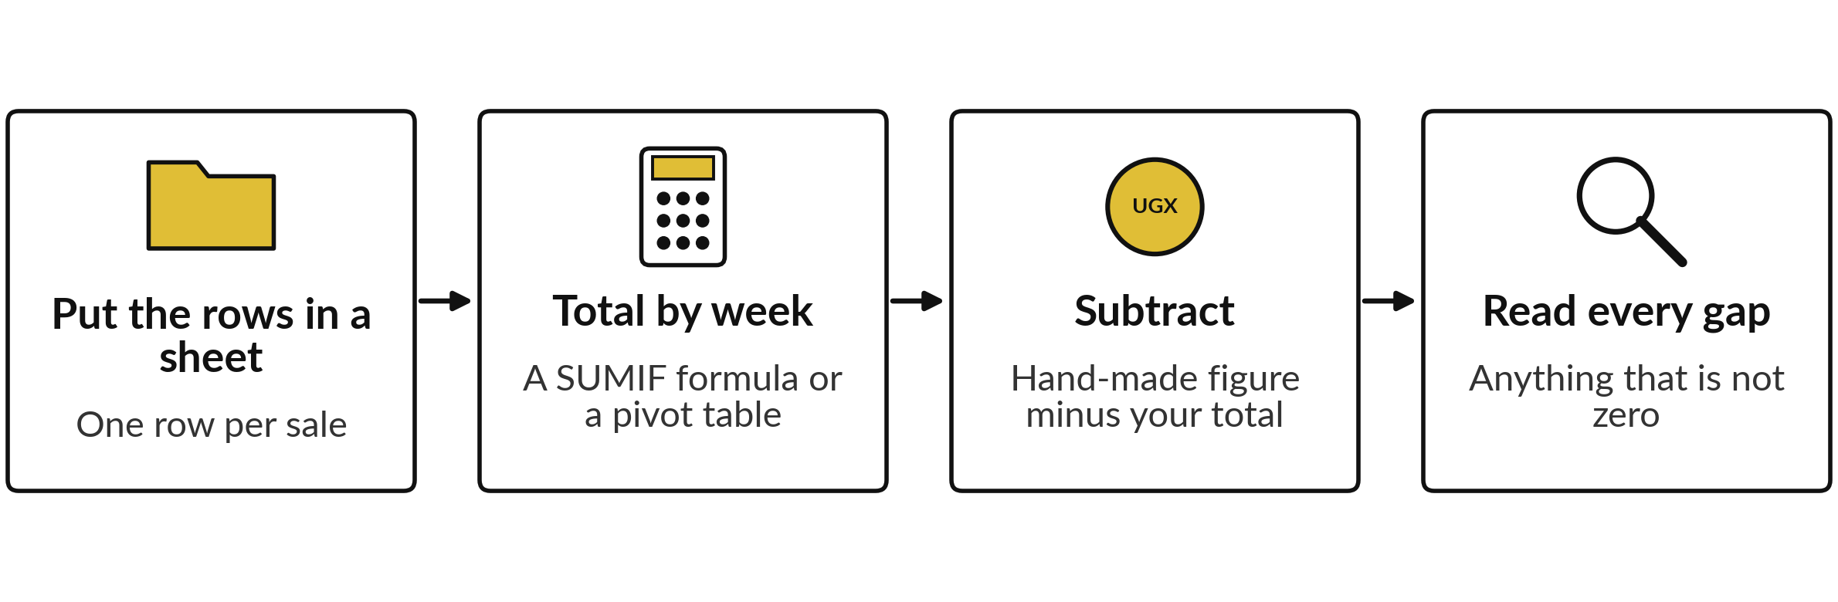
Recount the totals yourself in four steps
A formula follows the same rule every time. This takes minutes, and it is the control for wrong sums.
Notes:
This is the control for wrong sums, and I would use it every time a number matters. Put the rows in a sheet. Total them by week with a SUMIF formula or a pivot table. Put the hand-made figure beside your total and subtract. Then read every gap that is not zero.
A spreadsheet follows its formula the same way every time, so it becomes the authority, and the assistant becomes a second pair of eyes. Which numbers do you pass on today without recounting them?

Slide 17






In 27 runs the faults were few and
small, and only checking found them
Where | What went wrong | Runs
Session 1: sorting messages | M14 filed as Complaint; the key puts Payment first | 3 of 3
Session 2: market notes | Supply or roads given as causes that the notes do not support | 2 of 2
Session 3: weak email | Stock advice nobody asked for, and a name left blank | 1 of 1
Session 5: CV shortlist | Counted 2 years for a job from 2023 to now; about 3 | 1 of 2
Session 5: agreement | Said nine clauses comply; seven do, two have no rule | 1 of 2
Session 10: vendor proposal | Quoted “tens of thousands of invoices”; the proposal does not say it | 1 of 2
Claude, fresh session, prompt only, 4 Nov 2026, key hidden. No fault found in the invoice check, the hidden-instruction case or the five reply drafts, 2 runs each.
Notes:
Failures are the title of this session, so here are the ones we actually saw in all twenty-seven runs of this course, three in Session 1 and twenty-four more. Most of the eight runs in this session passed, so failures are the exception. They are also easy to miss.
Claude filed message M14 as a complaint in all three runs; the key puts the payment first. The weak email added stock advice nobody asked for. One CV run counted two years for a job held from 2023 to now. One agreement run said nine clauses comply when seven do.
And one vendor review quoted a phrase the proposal does not contain. I found no fault in the invoice check, the hidden instruction or the reply drafts. A small test that finds few faults does not show there are none. Checking still matters, and it costs minutes.

Slide 18


Four cases, four controls, one question each
Case | What happened | Control | Ask yourself
Made-up facts | Declined, both runs | Open every source yourself | Who opens the citations?
Beyond the document | 10 of 10 match the key | Give the document, ask for the clause, allow “not stated” | What if my file is silent?
Sources disagree | Both prices shown | Ask for both figures and sources | Where do my sources differ?
Wrong sums | All 12 totals right | Recount in a sheet | Which numbers go unchecked?
Claude, fresh session, prompt only, 4 Nov 2026, key hidden, 2 runs per case. Good results today do not promise good results tomorrow.
Notes:
Here are the four cases in one table, each with its control and one question for you. Notice what the good results tell you and what they do not. They show that a current assistant can decline to invent, stay inside a document, show a conflict and find real errors.
They do not tell you it will do so on your task, or on another day, or in another product. That is why the controls matter. Each one costs minutes and does not depend on the tool being right. Keep your own question from this table in mind, because after the break you use it.

Slide 19



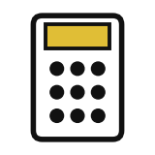
Decision: which failure would
hurt your company most?
Choose one, and give one example from your own task.
Made-up facts
Beyond the document
Sources disagree
Wrong sums
A name, case or source that does not exist
An answer the file does not support
A quiet pick between two figures
A total or percentage that looks right
Say your choice and your example aloud. Then we take the break.
Notes:
Before the break, each of you decides. Which of these four would hurt your company most, on your chosen task?
Made-up facts, an answer beyond the document, sources that disagree, or wrong sums. Say your choice and give one example from your own work. For a finance task it is often wrong sums. For a legal or compliance task it is often made-up sources. There is no right answer, only the one that fits your task, and it decides which check you write first after the break.

Slide 20
Checks for the Monday sales email,
written before any tool is used
Failure | Where it could show up | The check | Who and how long
Made-up facts | A reason for a sales dip that the data lack | Read for any cause not in the sheet | Peter Okello, 5 min
Beyond the document | A region or product not in the sheet | Compare names with the sheet | Peter Okello, 3 min
Sources disagree | Two sheets give two totals | Ask for both, then check the record sheet | Peter Okello, 2 min
Wrong sums | A total or a percentage | Recount in the sheet | Peter Okello, 10 min
A worked example from Nile Valley Foods. The checks add up to the 20 minutes of review in the plan. Nothing here is an AI result.
Notes:
Here is a finished example from Nile Valley Foods, so you see the level of detail before you write yours. It covers the Monday sales email. For each failure it says where it could show up, what check catches it, and who does it and for how long.
The times add up to twenty minutes, which is the review time in the plan we use for this email. These are checks I wrote before using any tool, and nothing here is an AI result. Notice that each check is a single action a person can do in minutes. That is the standard for yours.

Slide 21
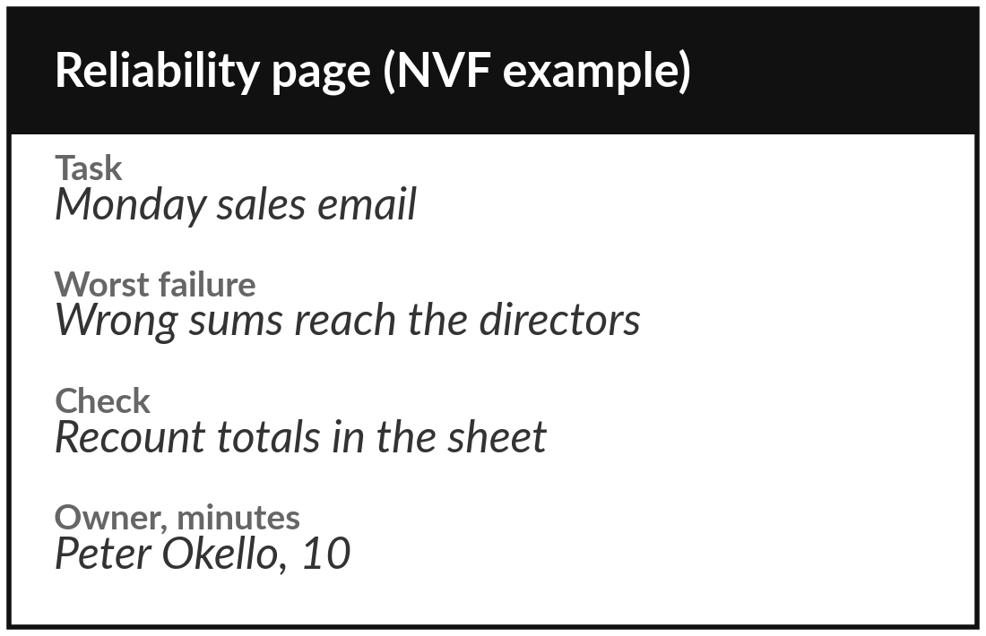
Practice: write the reliability
page for your own task
25 minutes
Your own company task
Write the failures that matter and the check for each.
Name your task and where AI text would enter it.
Mark the failures that could hurt it, starting with your choice.
Write one check for each, and who does it.
Estimate the minutes, then say your page aloud.
You keep: A reliability page: failures, checks, owners and minutes.
Notes:
Take twenty-five minutes. Write your reliability page for the one task you chose in Session 1. Name the task and say where AI text would enter it. Mark the failures that could hurt it, starting with the one you chose before the break. For each, write one check and who does it.
Estimate the minutes, and compare the total with the review time you wrote on your task card. We use no tool in class. Then, in the last five minutes of this block, say your page aloud to a neighbour, in about two minutes each. I walk round and read pages with you.

Slide 22



Decision: how far will you rely on
an AI tool for your task today?
Which description fits your own task?
Rely, with a check
Draft only
Keep away for now
A named check catches the failures that matter.
Useful first versions. A person rewrites and verifies.
A mistake would reach a customer or the bank unchecked.
Write your choice and its check on your reliability page.
Notes:
Time to decide. Which description fits your task today?
Rely with a check, because the checks you wrote catch the failures that matter. Draft only, because the tool saves time on a first version but a person rewrites and verifies. Or keep it away for now, because a mistake would reach a customer or the bank unchecked.
All three are good decisions when the checks support them. Say your choice aloud, with the main check, and write both on your page. In Session 3 you write the brief that puts those checks in front of the tool.

Slide 23
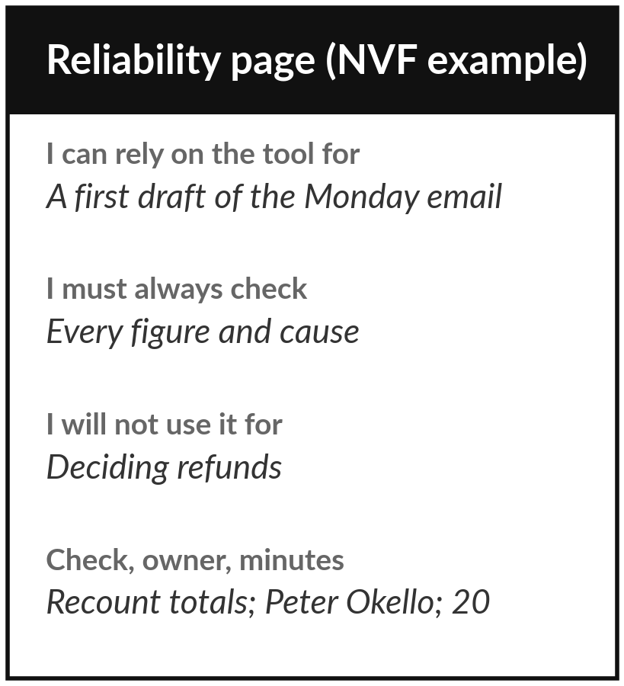
Save it, and keep it for Session 3
What you keep from today
Your reliability page for your own task, and the four controls from today.
Our question today
When can I trust what an AI tool tells me?
Next session
Session 3: Working with AI tools. Optional: think of what you would want the tool to produce for your task.
Notes:
Save your reliability page, because Session 3 uses it: the checks you wrote today become part of the brief you write there. Until your policy in Session 9, put nothing from your company into a tool.
We began with this question: When can I trust what an AI tool tells me? Before you go, say in one sentence what you can now say about it.

